Slide 1
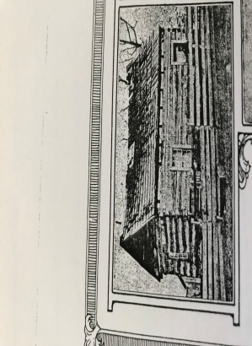
Our United Methodist Heritage The United Methodist Church of Mt. Pleasant,Pa. Prepared October of 2019
John Wesley (1703-1791)/Charles Wesley (1707-1788)
Led the revival of Methodism from England to America where Methodist Societies were formed beginning in the 1760’s.
Beginning In 1789 Circuit Rider Ministers (e.g. Jacob Pfrimmer and Abraham Draksel) began to cross over the mountains to the counties of Somerset, Westmoreland and Washington in Western Pa.
In 1784 , The Methodist Episcopal Church is formed.
Francis Asbury (1745-1816) and Thomas Cook (1747-1814) are named the church superintendents
1803 A Revival Meeting
Conducted by two traveling ministers
whose names were -Christian Newcomer
Christian Berger
They preached at the
Bonnet School in Mt. Pleasant, Pa.
And this revival meeting is known to be the origin of the Mt. Pleasant Church of the United Brethren in Christ
In 1800 The Church of the United Brethren in Christ was formed by Philip William Otterbein (1726-1813) and
Martin Boehm (1725-1812)
Picture of the Bonnet School in Mt . Pleasant, Pa.
*Prior to the Bonnet School, congregation members met in
Individual homes.
In 1807 Jacob Albright (1759-1808) founded the Evangelical Association which today is part of the United Methodist Church
Then between 1806-1812 a log house was
built at 26 S. Church St. Mt. Pleasant, Pa.
It was jointly owned by the United Brethren Church of Christ and the Associate Reformed Church
Separate services were held
United Brethren Services Presented in German
Associate Reformed Church Services Presented in English
In 1830 the log house was replaced with a brick structure and was
used by both
The United Brethren Church and The Associate Reformed Church
Separate services were held
1853 The United Brethren and the Associate Reformed Churches parted ways and the red brick structure was sold to Samuel Warden on behalf of the Associate Reformed Church
This Church later became the United Presbyterian Church
in Mt. Pleasant, Pa.

Slide 2
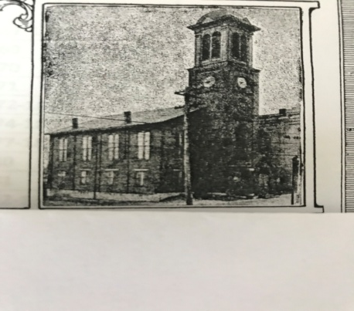
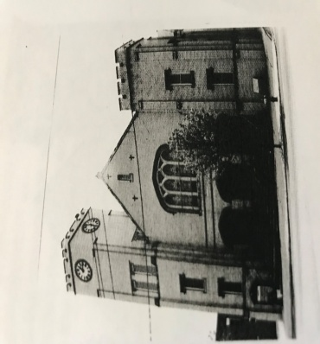
In 1854 The United Brethren built a new red brick Church on Main St. and College Ave. in Mt. Pleasant Pa.
(1854-1912)
(Church Incorporated in 1876)
This was the first church on the Main St. in Mt. Pleasant, Pa.
Membership at that time was 194
The church was built in 1854 –The church tower was constructed in 1874 and a clock was placed in the tower in 1890. The church parsonage was built 1876 at 714 Walnut St. Mt. Pleasant, Pa.
In 1912 the last service was held in this church as a decision was made to build a new church
From 1912-1913 –Services were held at the Mt. Pleasant Pa. Opera House while the new Church of the United Brethren was being built
On 3/16/1913 the newly built United Brethren Church on 645 W. Main St. Mt. Pleasant , Pa. was dedicated. Today it remains standing and is an active/vital place of worship.
At Johnstown, Pa. in 1946 The Evangelical United Brethren Church is formed from the merger of The Evangelical Church and The Church of the United Brethren in Christ
During 1912 and 1913 our current church was built
In the 1950’s and throughout continued improvements are being made at our church

Slide 3
At the time of the 1968 merger -- The Mt. Pleasant Church of the Evangelical United Brethren voted to change the church’s name to the Trinity United Methodist Church
1968
The Evangelical United Brethren and The Methodist Churches merged to form The United Methodist Church
Due to the fire, Sunday services were held in the Tree of Life Synagogue and church meetings were held at the Wesley United Methodist Church in Mt. Pleasant, Pa..
1985
A fire occurred in the sanctuary of The Trinity United Methodist Church at 645 W. Main St. in Mt. Pleasant, Pa.
1986
The church’s sanctuary was rebuilt and congregation returned
1839-1990
The Trinity United Methodist Church and The Wesley United Methodist Church were part of the U.M. Greensburg District
**From 1990-Present,
The United Methodist Church of Mt. Pleasant, Pa. is part of the Connellsville U.M. District
7/1/1990
The Trinity United Methodist Church and the Wesley United Methodist Church of Mt. Pleasant merged to
become
The United Methodist Church of Mt. Pleasant, Pa.
at 645 W Main St. Mt. Pleasant Pa,
The Wesley United Methodist Church also on West Main St.
Mt. Pleasant, Pa. is
two blocks from our United Methodist Church at 645 W. Main St.
Known by the community as
“The Town Clock Church”
The Clock in The United Methodist Church of Mt. Pleasant was dedicated on Sept./1992
and in
May/2001 was refurbished
The Mt. Pleasant Borough would be responsible for its maintenance
2017- Present
Rev. Robert Ellson is the current pastor .
The church continues to make improvements and is active with its mission to make and nurture disciples of Jesus Christ

Slide 4
This Heritage Chart of The United Methodist Church of Mt. Pleasant, Pa. was prepared by Charlene Borowiec and Wanda Ohler as a result of the United Methodist Heritage Class which we attended in Sept./Oct. of 2019
Class was led by Pastor Arnie McFarland, and was offered by the United Methodist Connellsville District Lay Servant School
In this study, we came to realize:
that the emphasis in all the Methodist traditions has been on evangelization, holy living and mission.
that authentic religion for Methodists means sharing the life of God whose love is poured out in Jesus Christ and whose Holy Spirit shapes us into the likeness of Christ and empowers us to be holy.
that Grace is God’s gift to us
that John Wesley and other early Methodists knew that the love for God and neighbor, requires a community of support and accountability
that public worship, participation in the Sacraments, private and public prayer, searching the scriptures, fasting and Christian conferences are acts of devotion in the Wesleyan tradition.
We would like to Acknowledge and say “Thank You” to all who directly and/or indirectly helped us on this venture to capture our Wesley United Methodist Heritage:
-Pastor Bob Ellson
-Diane Mickkelsen
-Those individuals who contributed to the United Methodist Church of Mt. Pleasant Bicentennial Celebration Booklet (1803-2003)
Betsy McFarland, Josephine Armor, William Armor, Carole Galley, Larry Galley, Ellen Hockenberry, George Hockenberry,
Jane Lauffer, Chester Leonard, Molly Leonard, Carole Malone, Claudia Stahl, and Bonnie Wilson.
In the last audible words of John Wesley before his death in 1791, he reaffirmed that faith shaped his life, “The best of all is, God is with us.”

